Slide 1
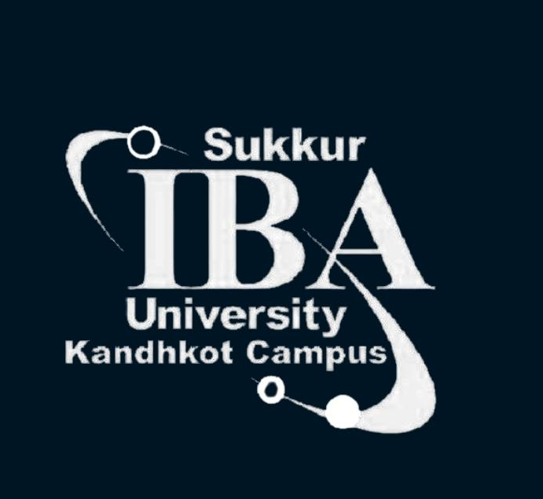

DATA SCIENCE ESSENTIALS
FOR BEGINNERS

Slide 2
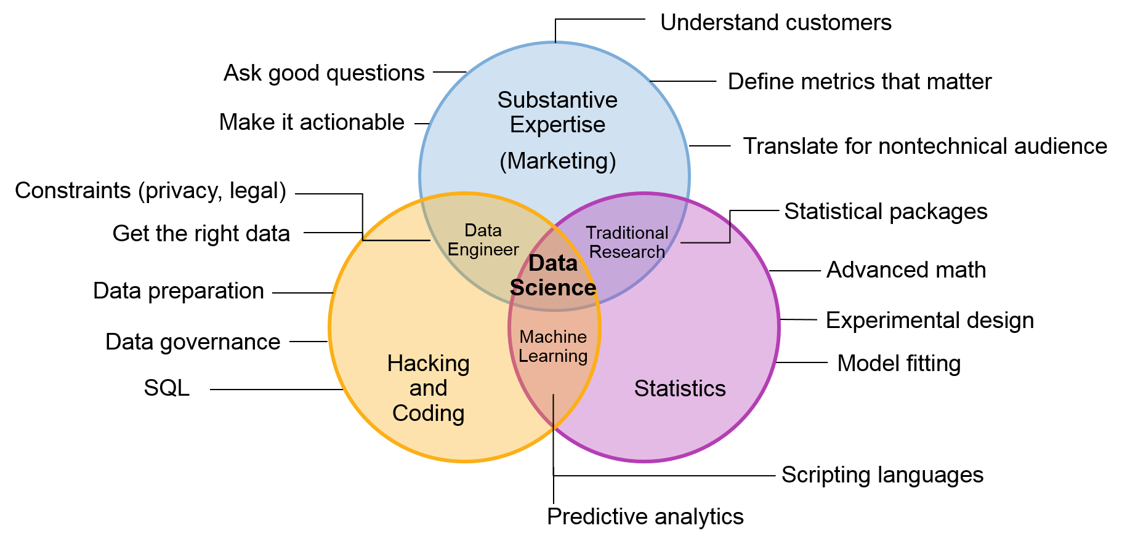
Predictive Analytics
DATA SCIENCE ESSENTIALS FOR BEGINNERS

Slide 3
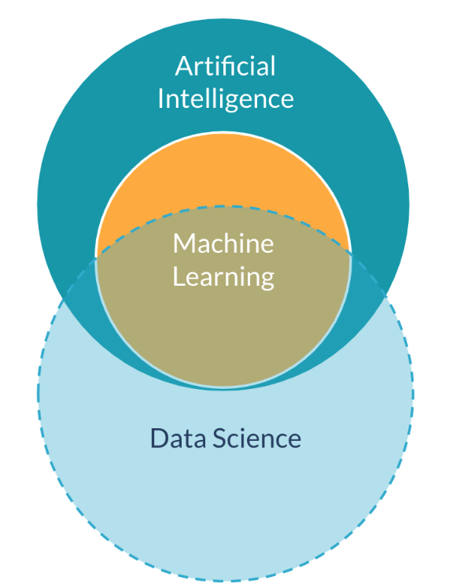
AI
Artificial Intelligence is a huge set of tools for making computers behave intelligently. Machine Learning is the most prevalent subset of AI.
ML
Machine learning is a set of tools for making inferences and predictions from data.
DS
Data Science is about making discoveries and creating insights form data. Machine Learning is an important tool for it.
DATA SCIENCE ESSENTIALS FOR BEGINNERS

Slide 4



Data
Analysis
Predictive Analytics
“ In-depth study of all the components of a given data set ”
“ Predictive analytics involve complex model-building and analysis in order to predict a future event or trend ”
Extract useful information:
trends, patterns, anomalies
More systematic and scientific approach:
Data aggregation, validation, cleansing, analysis, and Statistical/ML models
Past
Future
DATA SCIENCE ESSENTIALS FOR BEGINNERS

Slide 5
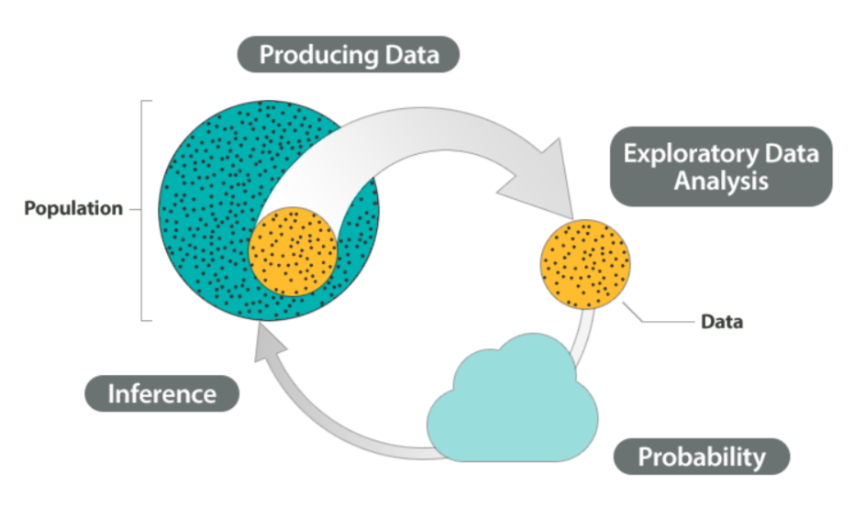
Statistics and Probability
Statistics is all about converting data into useful information. It is a process in which we
Collect data
Summarize data (Exploratory Data Analysis)
Interpret data
Statistical Inference is inferring something about the population based on what is measured in the sample.
All random samples are not same and may not represent the population perfectly. We use probability to quantify how much we expect random samples to vary.
DATA SCIENCE ESSENTIALS FOR BEGINNERS

Slide 6
Machine Learning: Definition
First definition of Machine Learning was given by Arthur Samuel (1959):
Field of study that gives computers the ability to learn without being explicitly programmed.
Before we talk about machine learning we need to talk about models.
A model is a representation of a mathematical or probabilistic relationship between different variables.
A machine learning model is a statistical representation of a real-world process based on data.
Machine learning is creating and using models that learn from data.
DATA SCIENCE ESSENTIALS FOR BEGINNERS

Slide 7
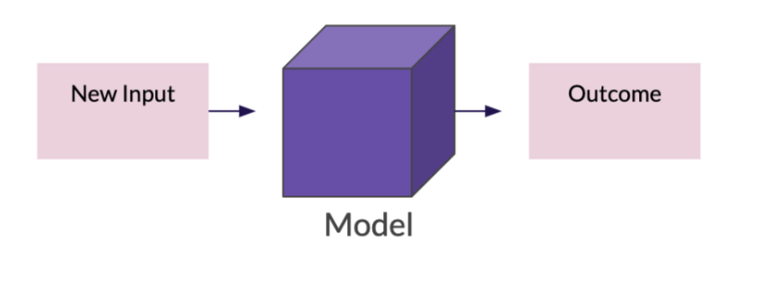
Machine Learning: Model
Instead of executing commands or following rules blindly, it produces a model which can be described as a formula that takes certain values as inputs and delivers one or more values as output.
X
f(x)
Y
DATA SCIENCE ESSENTIALS FOR BEGINNERS

Slide 8
Machine Learning: Model
Creation of a machine learning model requires two elements:
Model
Algorithm
Data
+
=
A procedure for solving a mathematical problem in a finite number of steps
DATA SCIENCE ESSENTIALS FOR BEGINNERS

Slide 9

Machine Learning: Model Training
Training the model is the process thorough which the algorithm goes through training data again and again, and helps the model make sense of the data.
Training Data
Algorithm
Distinguish patterns
Make accurate predictions on new data
Recommendations
Units of information that teach the machine trends and patterns derived from the data
Train the model
DATA SCIENCE ESSENTIALS FOR BEGINNERS

Slide 10
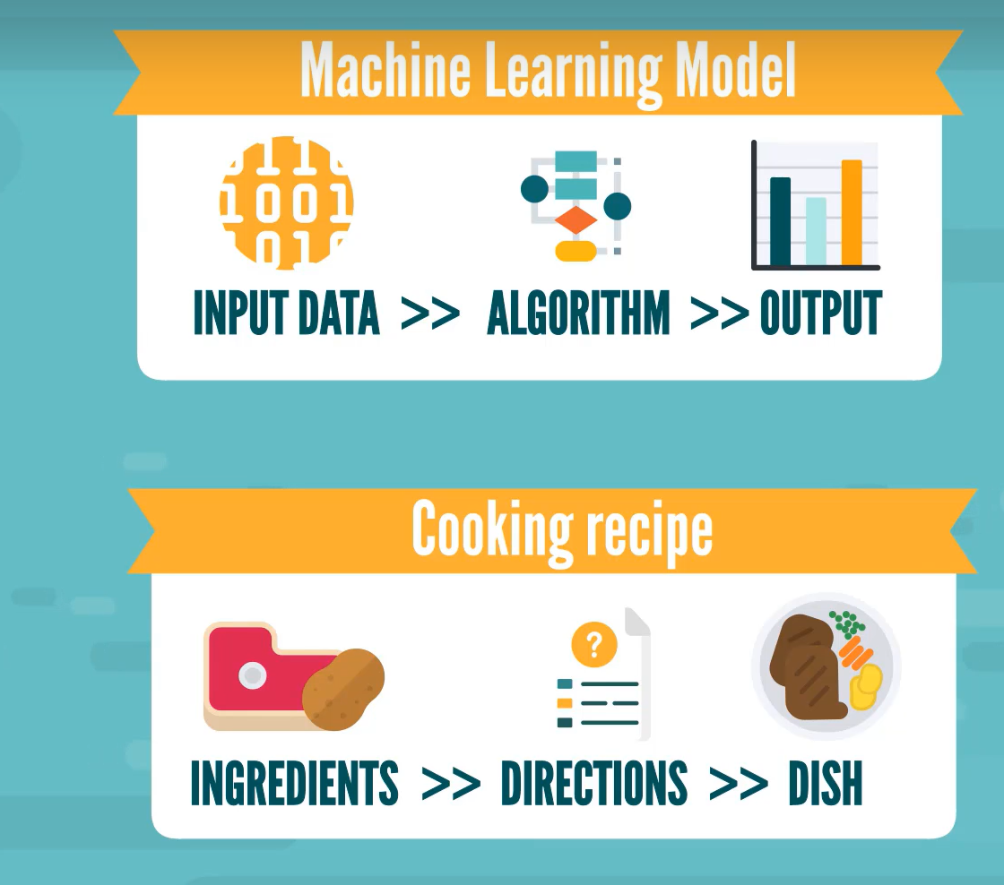
Machine Learning: Model Analogy
DATA SCIENCE ESSENTIALS FOR BEGINNERS

Slide 11
Machine Learning: Inference vs Prediction
Inference or causal models:
Goal is to understand the drivers of a business outcome
Inference focused models are interpretable
Less accurate than prediction models
Prediction:
The prediction itself is the main goal
Are not easily interpretable, i.e., work like black boxes
Much more accurate than inference models
DATA SCIENCE ESSENTIALS FOR BEGINNERS

Slide 12
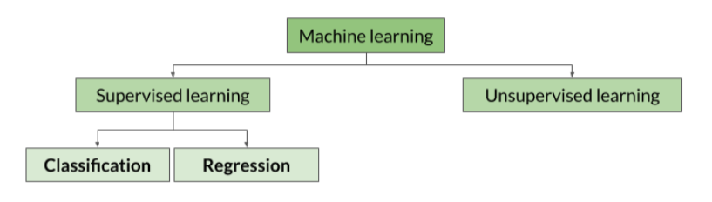
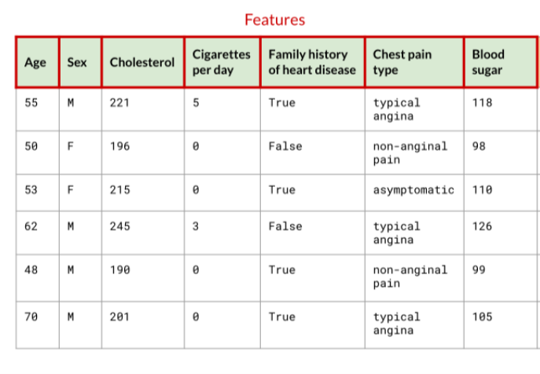
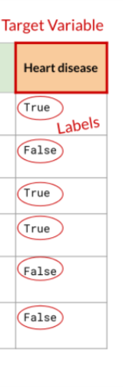

Machine Learning: Types
Supervised Learning
Training data is “labeled”
Predicting class/type of an outcome (Classification)
Predicting quantity of an outcome
Unsupervised Learning
Training data only has “features”
Clustering
DATA SCIENCE ESSENTIALS FOR BEGINNERS

Slide 13
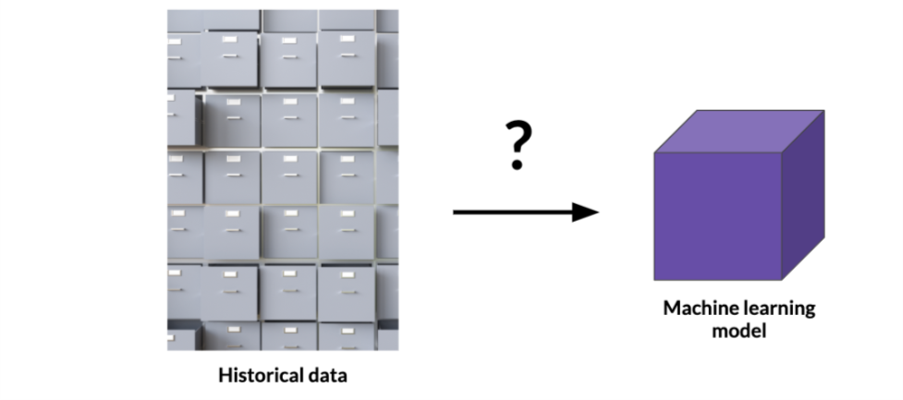
Machine Learning: Workflow
DATA SCIENCE ESSENTIALS FOR BEGINNERS

Slide 14

Machine Learning: Workflow
DATA SCIENCE ESSENTIALS FOR BEGINNERS

Slide 15
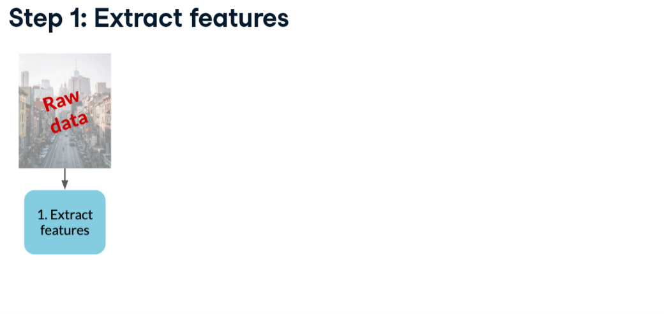
Machine Learning: Workflow
DATA SCIENCE ESSENTIALS FOR BEGINNERS

Slide 16
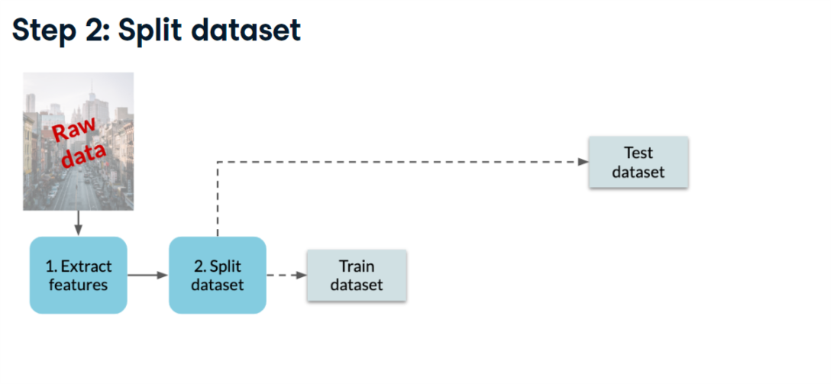
Machine Learning: Workflow
DATA SCIENCE ESSENTIALS FOR BEGINNERS

Slide 17
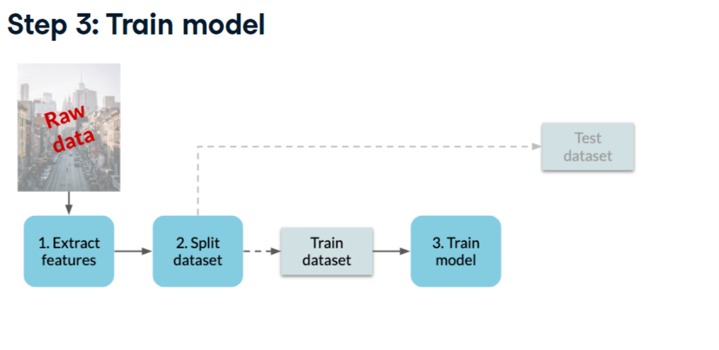
Machine Learning: Workflow
DATA SCIENCE ESSENTIALS FOR BEGINNERS

Slide 18
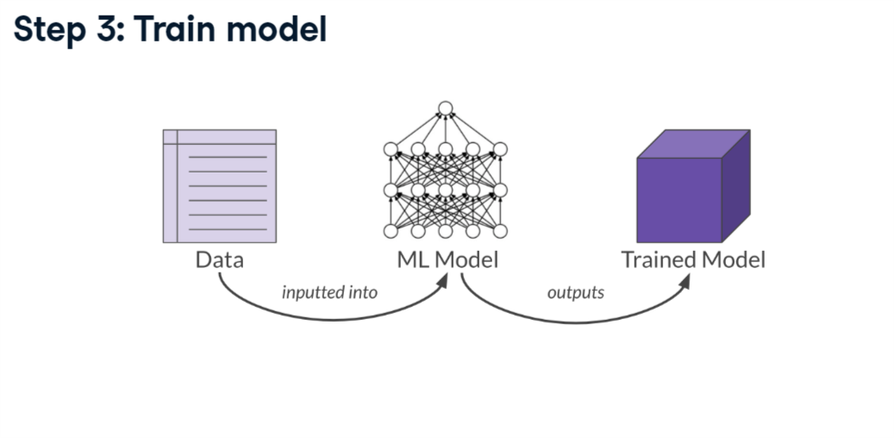
Machine Learning: Workflow
DATA SCIENCE ESSENTIALS FOR BEGINNERS

Slide 19
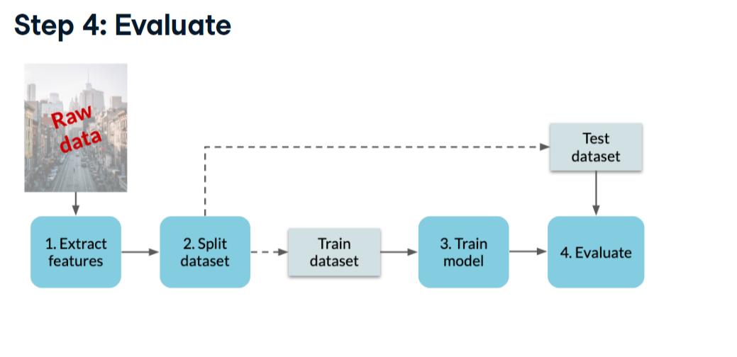
Machine Learning: Workflow
DATA SCIENCE ESSENTIALS FOR BEGINNERS

Slide 20
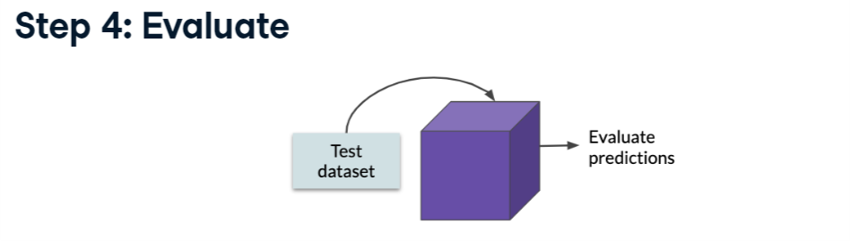
Machine Learning: Workflow
Test dataset: “unseen” data
Many ways to evaluate:
What is average error of the predictions?
DATA SCIENCE ESSENTIALS FOR BEGINNERS

Slide 21
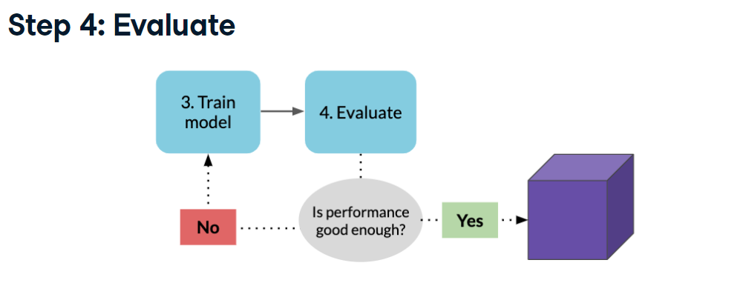
Machine Learning: Workflow
If not, tune the model and re-train it:
e.g., change the model’s options, add/remove features
DATA SCIENCE ESSENTIALS FOR BEGINNERS

Slide 22
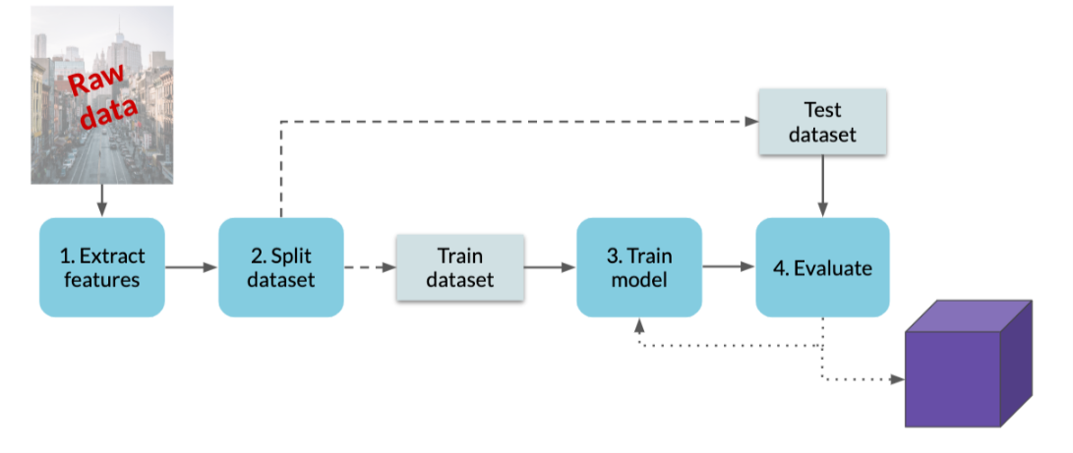
Machine Learning: Workflow
DATA SCIENCE ESSENTIALS FOR BEGINNERS

Slide 23
What Next?
Learn Machine Learning Algorithms: (KMeans, Logistic Regression, Decision Tree, etc.)
Learn Exploratory Data Analysis
Learn programming languages like Python and R.
Learn statistics and probability (Hypothesis testing, Distributions, etc.)
Find a business problem and solve it!
DATA SCIENCE ESSENTIALS FOR BEGINNERS

Slide 24
References
https://telenormicrofinance.udemy.com/course/the-data-literacy-course-learn-how-to-work-with-data/
https://www.kaggle.com/code/dansbecker/your-first-machine-learning-model
https://www.kaggle.com/code/dansbecker/how-models-work
https://www.scribbr.com/statistics/inferential-statistics/
https://campus.datacamp.com/courses/machine-learning-for-business
https://campus.datacamp.com/courses/machine-learning-for-everyone/machine-learning-models
https://www.coursera.org/learn/machine-learning
https://oli.cmu.edu/jcourse/lms/students/syllabus.do?section=729ec6a50a0001dc1fc85045eaf859e5
DATA SCIENCE ESSENTIALS FOR BEGINNERS

